Slide 1
PROPOSED TEST AUTOMATION APPROACH
THE SMART APPROACH

Slide 2
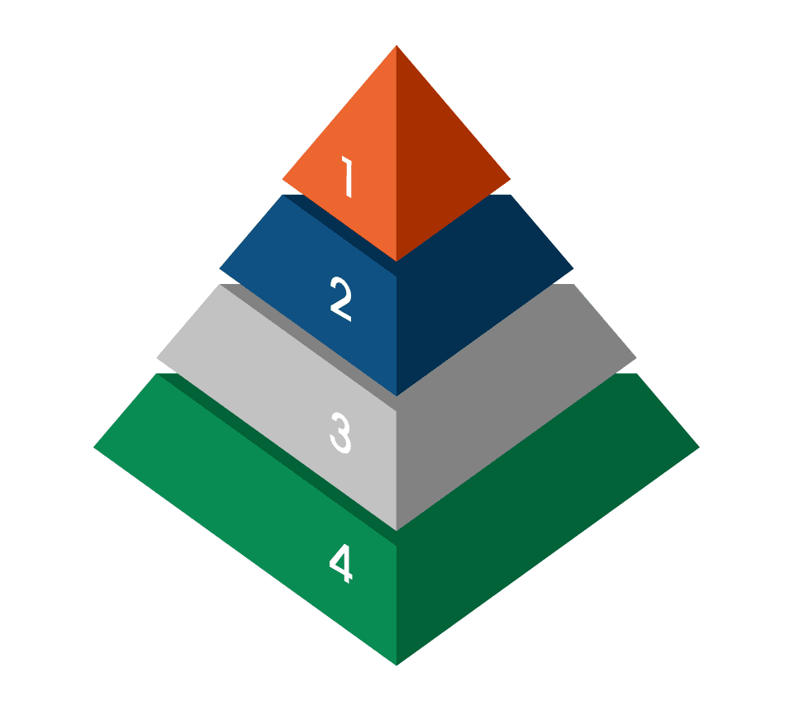
Our proposed SMART Approach to Automation Test
Specific Steps
Maintainable Codes
Accurate Acceptable Report
Relevant Code
Timely Test
SMART

Slide 3

SMARTER – Specific Steps
Direct navigation to test page
Every test does not necessarily need to start at the welcome screen
Less clicks and navigations to the form for specific test
Use navigations more for end to end testing
Use KCL Parser for a preconditions
Use Page Object Model for the UI Maps
Very specific steps for test conditions
Business oriented tests and scenarios
No duplicates. Review of previous tests required before writing a new one
The test scenario should directly link to the test schedule and builds
Always tag tests to build cycle e.g. Smoke Testing, Integration, Regression, e.t.c

Slide 4

SMARTER – MAINTENABLE Codes
Quality of codes and tests
Create future proof test framework
There is no point in creating non-maintainable codes
Same language as the application under test
For this reason the responsibility of writing, maintaining and executing the tests becomes a shared responsibility with developers
Easy to understand and manage structure
Easily portable
Handwritten codes that are easily to maintain

Slide 5

SMARTER – Accurate acceptable Reports
Rate of Success and Performance report
Create report that can be used to measure the rate of success and speed
Visibility of Reports
The metrics should be visible to all stakeholders
Give a clear visibility to the stakeholders on what to expect in automating
TOOLS: TeamCity / TFS (Azure DevOPs)

Slide 6


SMARTER – Relevant & Reliable
GUI Test results should be consistent and reliable
Test failure log should be relevant and useful for diagnosing the issue
Use appropriate logging libraries
Good and Reliable GUI tests
The GUI test should be reliable and meaningful
Simulating a user’s interaction with the application
Fail and Pass reliably
Fail Early
Learn from failure as soon as it occurs
Deliver to the consumer as soon as possible
Get real and fast feedback
Fail Better
With early and frequent failures all that is needed is to maximise the learning opportunities
Fix failure as soon as possible
Review consistent failing tests

Slide 7

SMARTER – Timely Test
Get quick feedback
Tests fail faster
Fail fast, reliably and consistently
Not slow tests
Ways of getting quick feedback are
Reduce number of waits (No Thread Sleeps!)
Only wait when required and fluently
And elements of improvement
Running the regression tests more frequently and
Automation Testing should not be seen as an isolated task
but rather as a coherent activity embedded in the SDLC

Slide 8
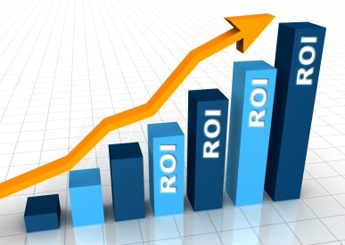
Cost Benefit Analysis OF SMARTER APPROACH
Benefits
Tests fail faster
Reduce cost of testing
Improve performance and feedback
Shorter testing cycle
Improves the effectiveness of testing
Improve software testing speed and quality while minimizing cost.

Slide 9
The

